Slide 1
Professional Retrospectives
Tuning the Engine of Change
jasonknight@bokf.com
Notes:
Good afternoon folks! I’d like to share my experience with creating and facilitating professional Scrum Retrospectives today. It’s my opinion that the Retrospective is the single-most important of the 5 Scrum events. My goal is not to convince you this opinion is right. My goal is to persuade you to invest time and effort cultivating your facilitation practices and tuning your Retrospectives into the engines of change they are designed to be.

Slide 2
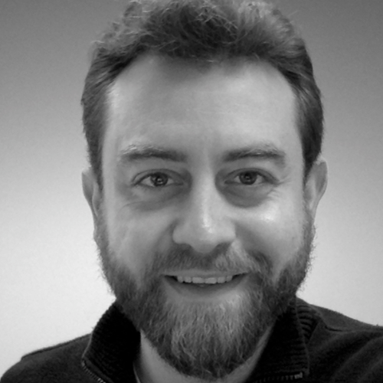
Jason Knight
Husband and father
Software Developer
Meetup Organizer
Professional Scrum Master (CSM, PSPO, PSM, SPC, PSD)
Scrum.org Professional Scrum Trainer Alumni (PST)
Lean Coach
I encourage and equip people to do their best work
jasonknight@bokf.com
Notes:
I’d like to start by telling you a story of a Retrospective I participated in many years ago…

Slide 3
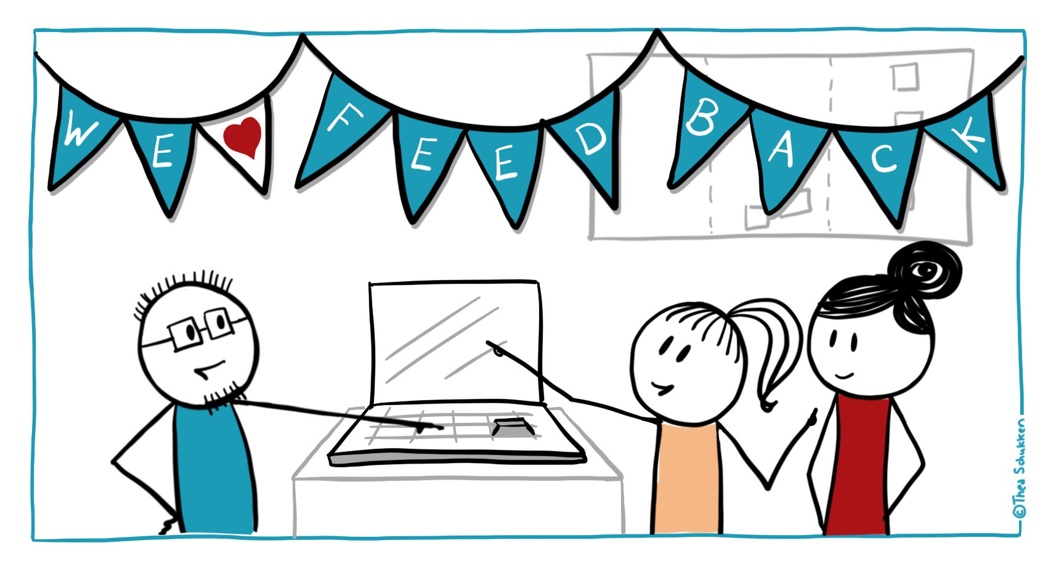
jasonknight@bokf.com
Notes:
Back then, I was a newly minted Scrum Master sharing a Development Team Member role on a Scrum team. We had just concluded a Sprint Review and were making our way back to our team area. I had prepared to facilitate on that day.

Slide 4
Retrospective Quadrant Exercise
Loving!
Change, STAT!
More of
Less of
jasonknight@bokf.com
Notes:
We were using something like this 4-Quadrant Exercise. Each person would have a few minutes to write about their experience of the last Sprint. On colored stickies, they would record things they loved, wanted more of, less of and things that needed to change as soon as possible. Everything proceeded normally, until our Product Owner posted what she wrote under the “Change, STAT!” quadrant.

Slide 5

She felt like she was drowning.
Photo by nikko macaspac on Unsplash
jasonknight@bokf.com
Notes:
Our product owner told us she was under water. She struggled each Sprint to get backlog items ready for us, balance customer outreach, and the myriad other little things that sapped her time and energy. She hadn’t had a vacation in 2 years. To her, it felt like she was drowning.
Here’s a question for you all…

Slide 6
Was it our job to help her
?
jasonknight@bokf.com
Notes:
…was it our job to help her? This is in fact her role, her job and not ours. We had our own problems to deal with that were no less real. If we spent time helping her, we might not achieve as much individually or as a Development team. We had to answer to our stakeholders for our progress after all.

Slide 7
What if you were the one drowning
?
jasonknight@bokf.com
Notes:
Would you want your team to help you if you were feeling this way? If you chose to help, would you be operating in-line with your personal feelings or an established company process? Would you personal framework line up with the framework of your work expectations?
Luckily, if a team is adhering to the Scrum framework, this is exactly the sort of problem the whole team is not only allowed but obligated to solve. We were at the right place and the right time. We were in our Sprint Retrospective.

Slide 8
What is the purpose of a Scrum Retrospective?
Inspect the last Sprint
1
Identify what went well and possible improvements
2
Create a plan for possible improvements
3
jasonknight@bokf.com
Notes:
The purposes of the Sprint Retrospective is to:
Inspect how the last Sprint went with regards to people, relationships, process, and tools;
Identify and order the major items that went well and potential improvements; and,
Create a plan for implementing improvements to the way the Scrum Team does its work.
Notice, the Scrum guide gives purposes that:
Create an inspect and adapt cycle for the whole team
Give 4 distinctions to use when inspecting the whole team
Bias the team towards action rather than fruitless discussion or unproductive venting sessions

Slide 9
What does the team inspect?
People
Relationships (“5 Dysfunctions of a Team”)
Processes
Tools
Notes:
A Scrum Team is aided in their inspection by these 4 distinctions.
Here, people refers to an individual’s capacity to effectively contribute to achieving the Scrum team’s goals. These are things like: abilities, skills, attitudes, mental health, access to resources, and so on.
Relationships refer to the health and effectiveness of team members interactions. You can refer to Patrick Lencioni’s “5 Dysfunctions of a team” as a way of gaugin the health and effectivenss of your team’s interactions.
Processes refer to standard work procedures the team uses to accomplish its goals. These are things like gaining PO agreement on a product backlog item’s implementation or a source control branching scheme.
Tools refer to the implements the team uses to do their work. Examples would be computers, Jira, Slack, or a white boarding tool like Miro.

Slide 10
Who should attend?
(Facilitator)
Product Owner
Development Team
Scrum Master
jasonknight@bokf.com
Notes:
Since the purposes of the Retrospective encompass the entire Scrum team, the entire team must attend. The Scrum guide does not specify who should facilitate, but does say that the Scrum Master should:
Ensure that the event takes place and attendants understand its purpose
Ensure the meeting is positive and productive
Teaches all to keep it within the time-box
Participates as a peer team member
Encourages the Scrum Team to improve, within the Scrum process framework…to make it more effective and enjoyable for the next Sprint.
The Scrum Master is obliged to facilitate Scrum events as requested or needed as part of her duty to the Product Owner and the Development team.
In short, who should facilitate a Sprint Retrospective? The answer is the same for any of the 5 Scrum Events: any Scrum team members may facilitate, but if all others decline it is the Scrum Master’s duty to facilitate.

Slide 11
Design is very important
jasonknight@bokf.com
Notes:
Not all facilitation is created equal. The design of professional facilitation is very important. You know intuitively that design can be very important.

Slide 12
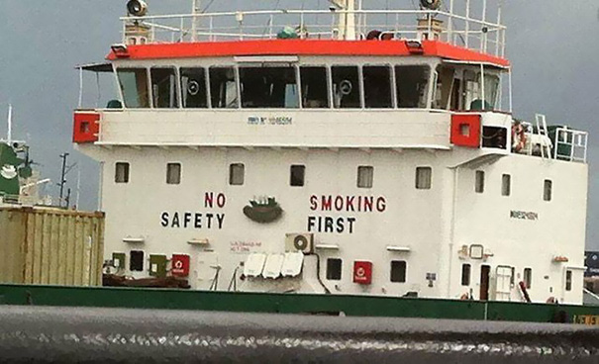
Uh, I’ll find another boat.
Notes:
Some design creates confusion and raises questions about competence.

Slide 13
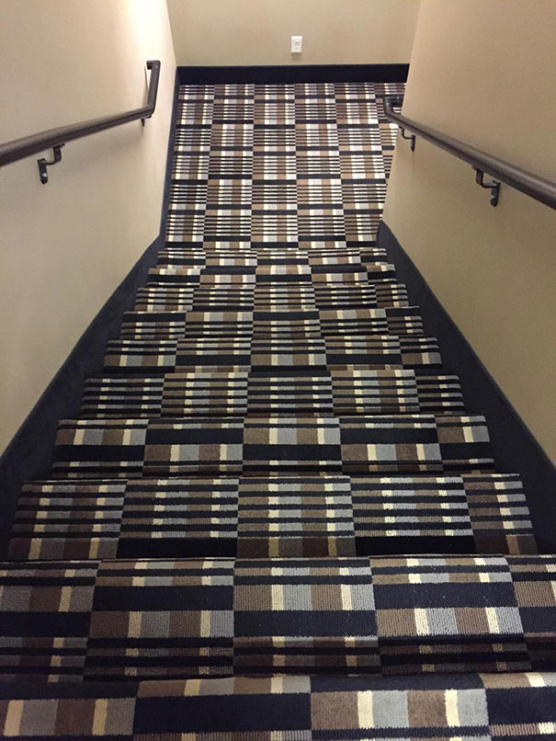
I’ll take the elevator…
Notes:
Some is clearly problematic and will put folks off of your effort entirely.

Slide 14

Who approved these?!
Notes:
And some design rises to the level of outright threat to health and wellbeing. Wait, what about self-organization? Should we just create the space for a retrospective and let the team “self-organize” a discussion in a retrospective?

Slide 15
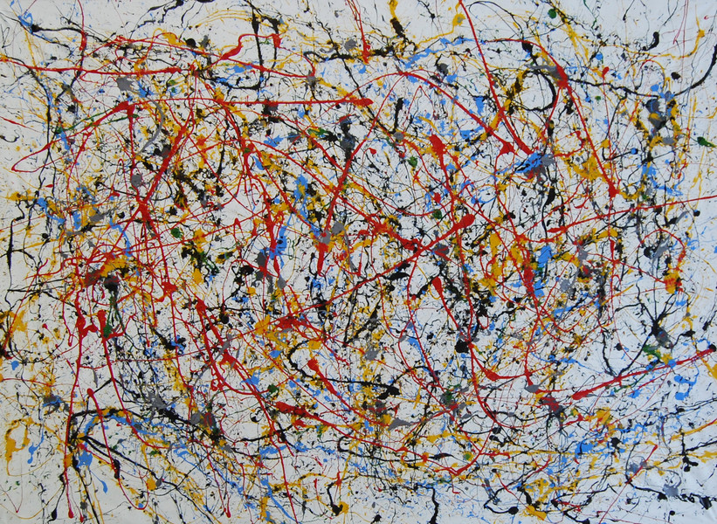
No design can be
beautiful, but…
Chaos – 2019 by Tic
Notes:
Humans are quite good as self-organizing and a Scrum Team may indeed create a spontaneous, beautiful and effective Retrospective. However in “The Wisdom of Crowds” we learn that to cognize, coordinate and collaborate well crowds are aided by:
Diversity of opinion
Independence
Decentralization
Aggregation
Trust
These elements are not guaranteed in a free-for-all conversation, but a well-designed retrospective can reliably ensure these conditions are present.

Slide 16

In a professional Retrospective, people…
Waiter sets the table
Set the stage
Let me get you the check.
Any food allergies?
Close
Gather data
What’ll you have?
Let me tell you about our specials
Decide what to do
Generate Insights
jasonknight@gmail.com
Notes:
Here is the framework I use in my retrospectives. It is a structured progression of activities each designed to establish trust, reveal diverse opinion, decentralize responses, enable independent thought, and aggregate information.
You are already well acquainted with this cycle. Just think of your last, dining experience. The waiter:
Sets the table or facilitates your dining experience through preparation
Gathers necessary data from the individual diners
Generates insights by combining diner preference with menu specialties
Moves the group to decide on their choices
And closes the experience by bringing the check
Each stage prepares for and makes easier the way into the next. Can you see how it is easier to generate insights only after generating data? What if instead of starting a Retro off with a check-in, you all were immediately asked to list your desired improvements for the next Sprint? This is the art of facilitation. It creates a space within which the way forward is easier.
Let’s look at some examples.

Slide 17
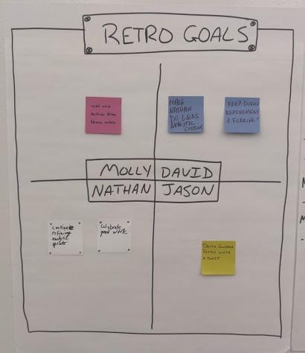
Set the stage
Source: https://retromat.org/en/?id=81-78-68-117-101
jasonknight@gmail.com
Notes:
This is a “Set the Stage” exercise from retromat.org where everyone in the team states their goal for the retro. Examples could be:
I’m happy if we get 1 good action item
I want to talk about our argument about unit tests. That was painful, and I don’t want to have it again.
Our source control stinks! I’d consider this retro a success if we could form a plan to improve our use of it or go shopping for a new one.
Notice, this prompts folks not to propose concrete improvements but to surface general things which they want to see addressed or outcomes that feel like success. This usually comes quickly and easily while revealing “what is present” in the team right at the outset. The facilitate may use these as orienting elements throughout the rest of the retrospective.

Slide 18
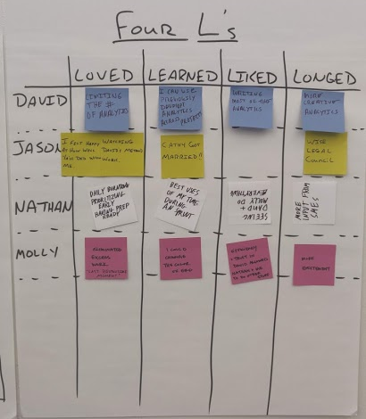
Gather Data
Source: https://retromat.org/en/?id=81-78-68-117-101
jasonknight@bokf.com
Notes:
This exercise is called “The 4 L’s” in which each team member thinks more specifically about the big and small things that they Loved, Learned, Liked and Longed for throughout the Sprint. Each of these are distinct frames which more easily evoke memories of the Sprint and provide data from which patterns may arise. Each person is encouraged to write their own in silence to avoid monopolizing conversation or anchoring other’s opinion. A diverse set of opinions emerges and may be grouped to reveal patterns.

Slide 19
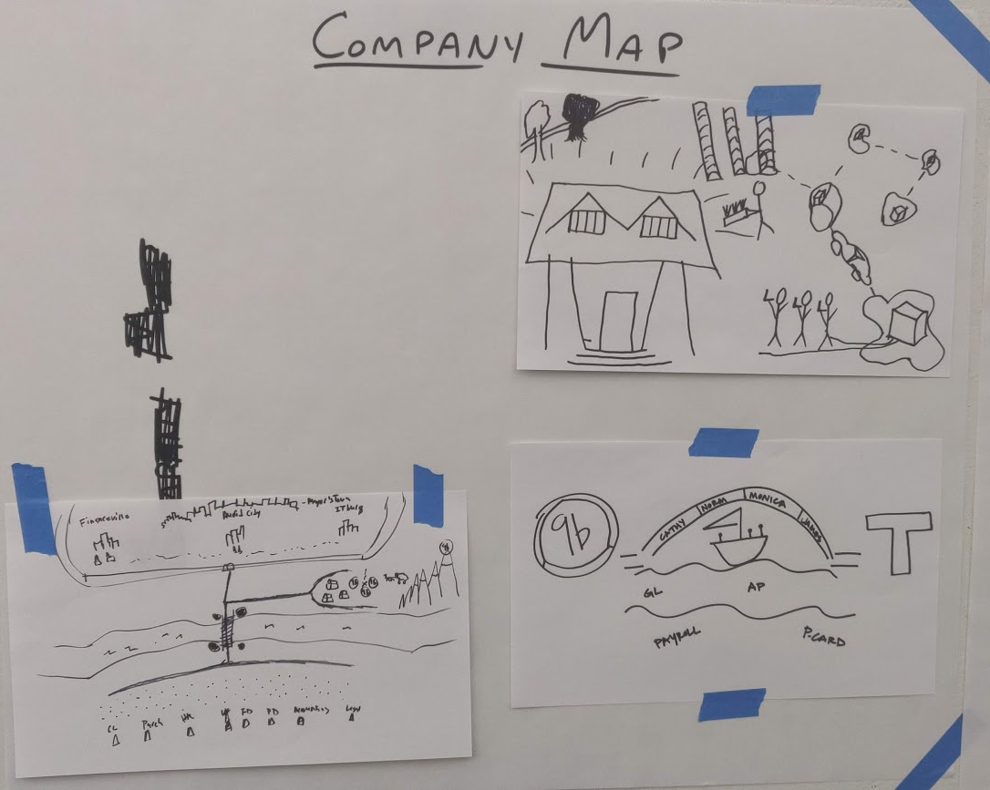
Generate Insights
Source: https://retromat.org/en/?id=81-78-68-117-101
jasonknight@bokf.com
Notes:
This exercise is a fun one. In it, each team member is handed a sheet of paper and a pen and asked to draw a map or the company. The question is posed, “What if the company / department / team was a territory? What would a map for it look like? What hints would you add for safe travelling?’ The team get’s 5 – 10 minutes to draw. The process of creating a map engages the mind creatively and promotes exploration of the data generated so far. Impediments may show up as dangerous rivers crossed only by a rickety bridge. Wonderfully positive practices may be drawn like golden meadows of automated test coverage that the code skips through on it’s way to a grateful customer. For maximum effect, I suggest playing the “Game of Thrones” theme song on repeat as each team member builds out their conceptual kingdom ☺.

Slide 20
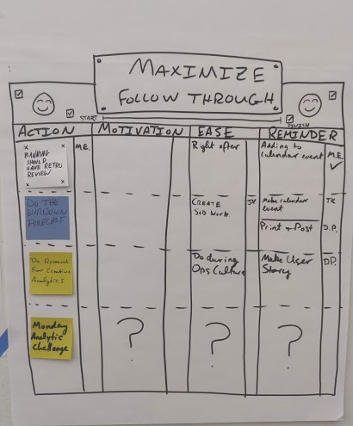
Decide what to do
Source: https://retromat.org/en/?id=81-78-68-117-101
jasonknight@bokf.com
Notes:
And then there comes the rub: what are we going to do about what has emerged? This exercise is designed to maximize follow-through on proposed ideas. After actions are proposed, they are ordered by the team. Next, several questions are asked of each action:
What could increase your motivation to complete this action?
What could make it easier?
What sort of reminder would you like to have?
Those who volunteer to motivate, facilitate (see what I did there?), or remind write their initials next to those helping actions. In this way, an individual is actively helped and encouraged to take responsibility for their proposed actions.

Slide 21
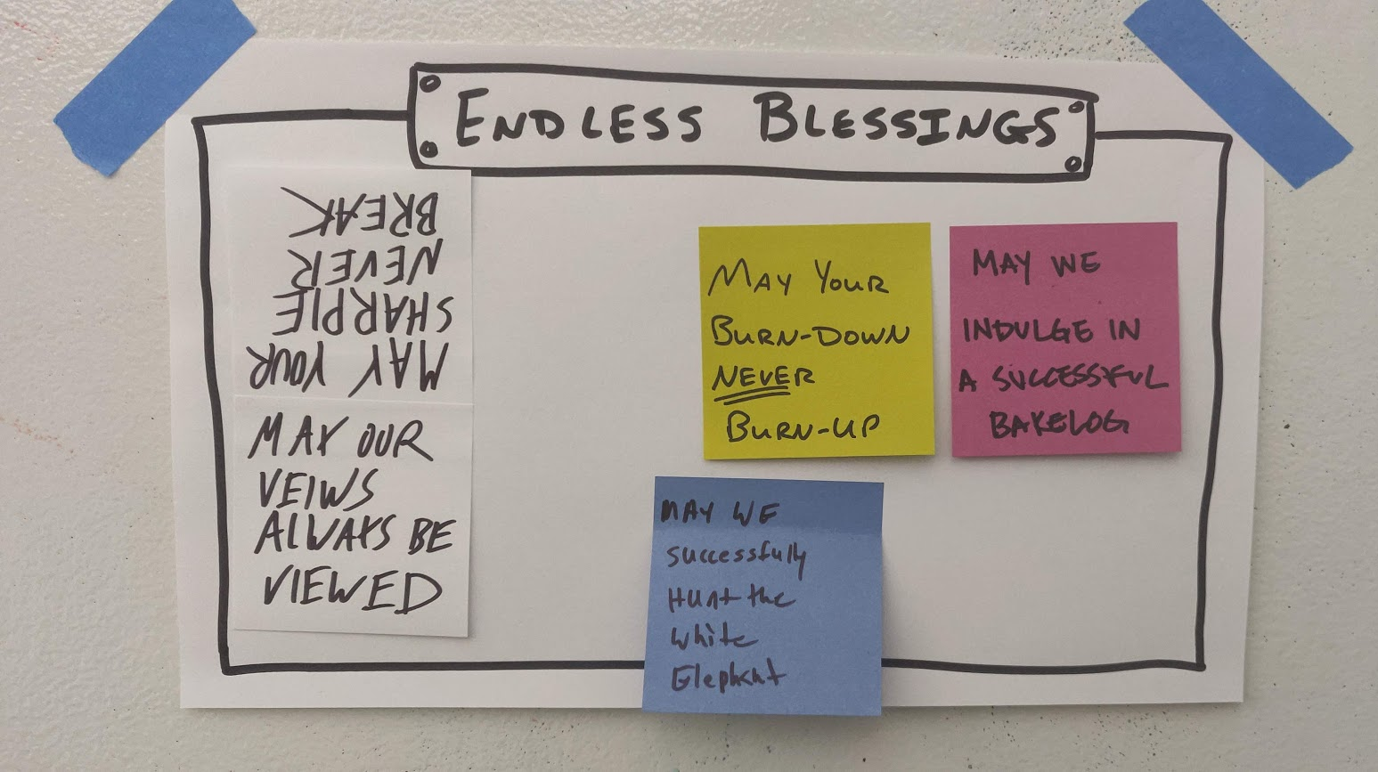
Close
Source: https://retromat.org/en/?id=81-78-68-117-101
jasonknight@bokf.com
Notes:
Retrospectives can be hard work, so closing them properly and positively is important. This is an exercise called “Endless Blessings” in which each team member is asked to pronounce a blessing on the team or on individuals for the next Sprint. Some examples you see here are:
May your burn-down never burn-up
May we successfully hunt the white elephant
(upside-down) May your sharpie never break
It may seem cheezy, but this really works to solidify good will and promote trust within the Scrum team. As you can probably guess, some funny inside jokes can come out of it as well ;).

Slide 22
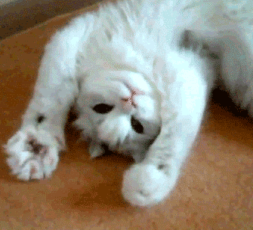

Let’s paws for your thoughts and questions.
jasonknight@bokf.com
Notes:
And now let’s paws to hear from you. What thoughts are you having about all of this? What have you experienced in your Retrospectives?
If you are seeing some promise in these facilitation practices, your next question might be, “How can I prepare to run a retrospective like that!?”

Slide 23
Create a plan for a retrospective
Decide
who should be there
your activities (use the Retromat)
List
supplies and tools you’ll need
Set
Pick
time aside (2x Retrospective timebox)
jasonknight@bokf.com
Notes:
Your first step is to decide who needs to be there. If you are on a Scrum team, the answer is “everyone on the Scrum team.” You must also decide what “there” means when deciding who should be there. I would suggest no shorter than a 60 minute timebox for a 2 week Sprint, though 90 minutes would probably be better if you are new to these facilitation techniques.
As a rule of thumb, block off twice the time of your Retrospective timebox to prepare. This preparation time will go down as you become more skilled.
Next, use a tool like Corinna Baldauf’s Retromat to select the right exercises for your team and your Sprint. All Sprints and teams are different, but fortunately Corinna has built a tool that boasts over 140 activities allowing for over 12 million distinct combinations. You’re sure to find something that will make for an acceptable structure.
Last, most exercises will call for some sort of supply or tool preparation. Depending on your activities, you will need to prepare online whiteboards, easel pads, post-its, one-note documents, and a host of other possible materials. Make a list of the supplies and tools that your activities call for.

Slide 24
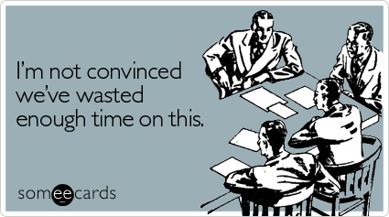
jasonknight@bokf.com
Notes:
This will be hard work at first, so remind yourself of how often meetings are a complete waste of time. If you allow your retrospectives to become aimless discussion or unharnessed venting that does not reliably produce plans for improvements, then you and your team may start saying things like this:
Let’s cut the Retro to 30 minutes or less.
Let’s combine the Retrospective with the Sprint Review
This retro is of little or no value to me.
We should get rid of this waste of time meeting.
In contrast, if you dedicate yourself to learning professional facilitation techniques like those I’ve described, you’ll likely hear statements like these:
I never knew you felt that way…
That was fun! Or simply laughter
I know what to do
I believe next Sprint will be better
This last one is important. If the Scrum team becomes confident that “next Sprint will be better” then you have tuned and oiled your Retrospectives to be the engine of change there are intended to be.
Before I conclude, I’d like to share the rest of the story of my former Product Owner.

Slide 25
What did our team adapt?
People
Relationships
Processes
Tools
Notes:
We decided that our Product Owner’s problems were our problems. Our Retrospective revealed that improvements were needed in all 4 categories of retrospective improvements.
Personally, she was overworked, would likely burnout, and would probably leave the company or her position
Relationally, she was feeling alone and powerless to enact change.
Procedurally, our refinements and her systematic management of the backlog took too much of her time and yielded too few “Ready” work items for the Dev Team to work on in Sprints.
Regarding our tools, our tools made it difficult for one person (usually our Product Owner) to quickly reference and update our work items while still remaining engaged in our refinements.
In response, we decided that our Scrum Master (me) would partially refine stories with her ahead of time so she could learn better techniques and so more could be made “Ready” in our team refinement meetings. We decided our refinement process should be facilitated differently. With rotating team members held to a 4 minute timebox, they would read a story from a pre-pared easel sheet, jot down team changes and estimates, and take personal responsibility to update work items according to their notes.
The results? We increased our refinement output from 2-3 stories in an hour to 20+ in 90 minutes. Our Product Owner got the relational support and practical skills she needed to spend less time managing the backlog, AND our team had plenty of “Ready” work for our Sprint Plannings.
Oh, and one more thing…

Slide 26

Two weeks in the Caribbean, no communication!
Photo by Emily Bauman on Unsplash
jasonknight@bokf.com
Notes:
Our product owner took a 2 week Caribbean vacation. She left her work phone and laptop at home ☺.

Slide 27
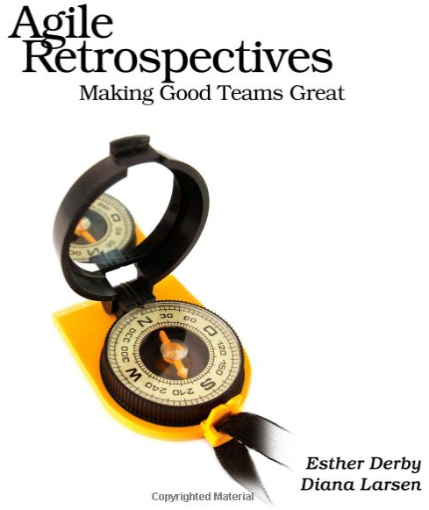
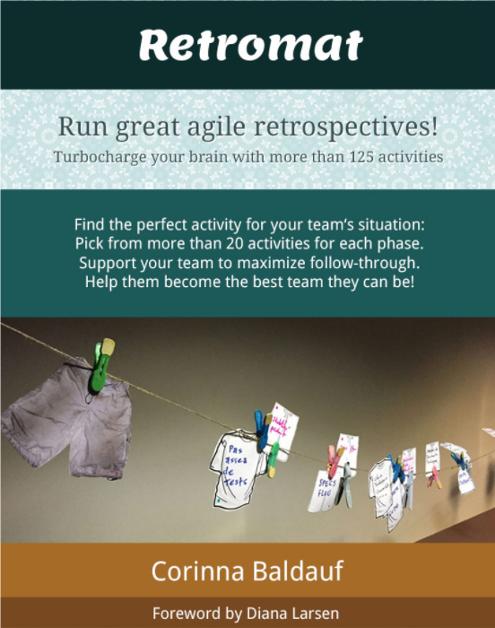
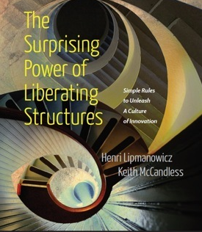
Purpose of a Retrospective
Create a plan for possible improvements
Structure of a professional Retrospective
Set the stage
Gather Data
Generate Insights
Decide what to do
Happy Retrospecting!
Close
https://www.amazon.com/Agile-Retrospectives-Making-Teams-Great/dp/0977616649
https://retromat.org
http://www.liberatingstructures.com/
jasonknight@bokf.com
Notes:
Over the past few minutes, we’ve reviewed the purpose of the Sprint Retrospective, the facilitative structures that make the way to improvements easier, and heard reference to a helpful tool for choosing Retrospective activities. I’d like to leave you with this very screenshottable last slide (hint, hint) as well as a couple books and tools. They have helped me on my journey as a facilitator to encourage and equip people to do their best work. I’m confident the can provide the same for you.
Thank you ☺.

